Slide 1



Sales Analysis Reports
View in Power BI
Last data refresh:
5/27/2022 3:34:01 PM UTC
Downloaded at:
5/27/2022 3:38:45 PM UTC

Slide 2
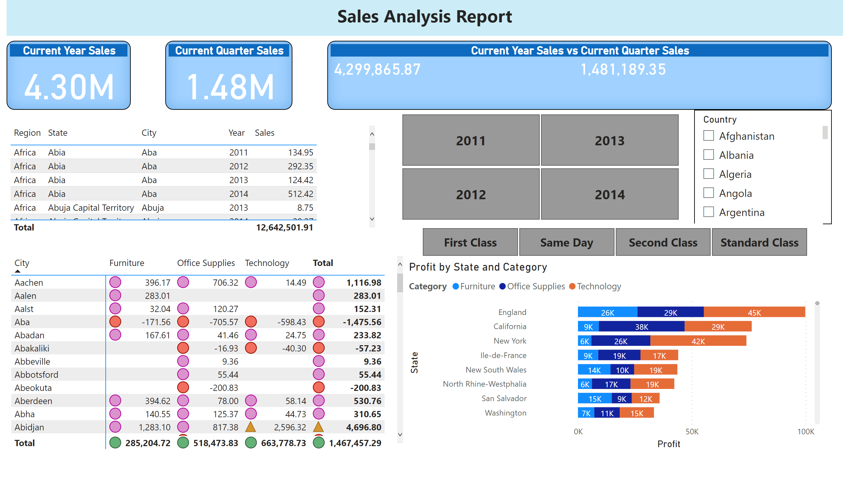
Page Settings Demo
Notes:
textbox
No alt text provided
Current Year Sales
No alt text provided
Current Quarter Sales
No alt text provided
Current Year Sales vs Current Quarter Sales
No alt text provided
tableEx
No alt text provided
pivotTable
No alt text provided
slicer
No alt text provided
slicer
No alt text provided
slicer
No alt text provided
barChart
No alt text provided

Slide 3
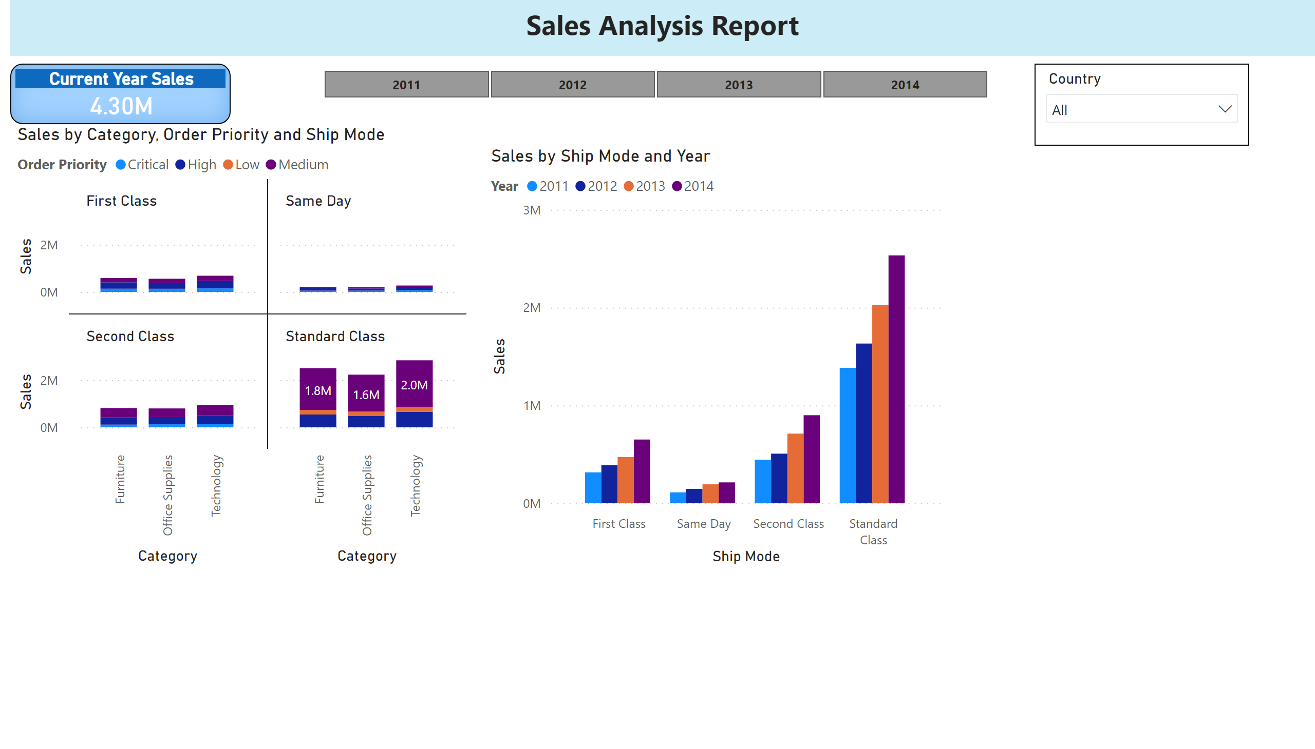
Page 2
Notes:
textbox
No alt text provided
Current Year Sales
No alt text provided
slicer
No alt text provided
slicer
No alt text provided
columnChart
No alt text provided
clusteredColumnChart
No alt text provided

Slide 4
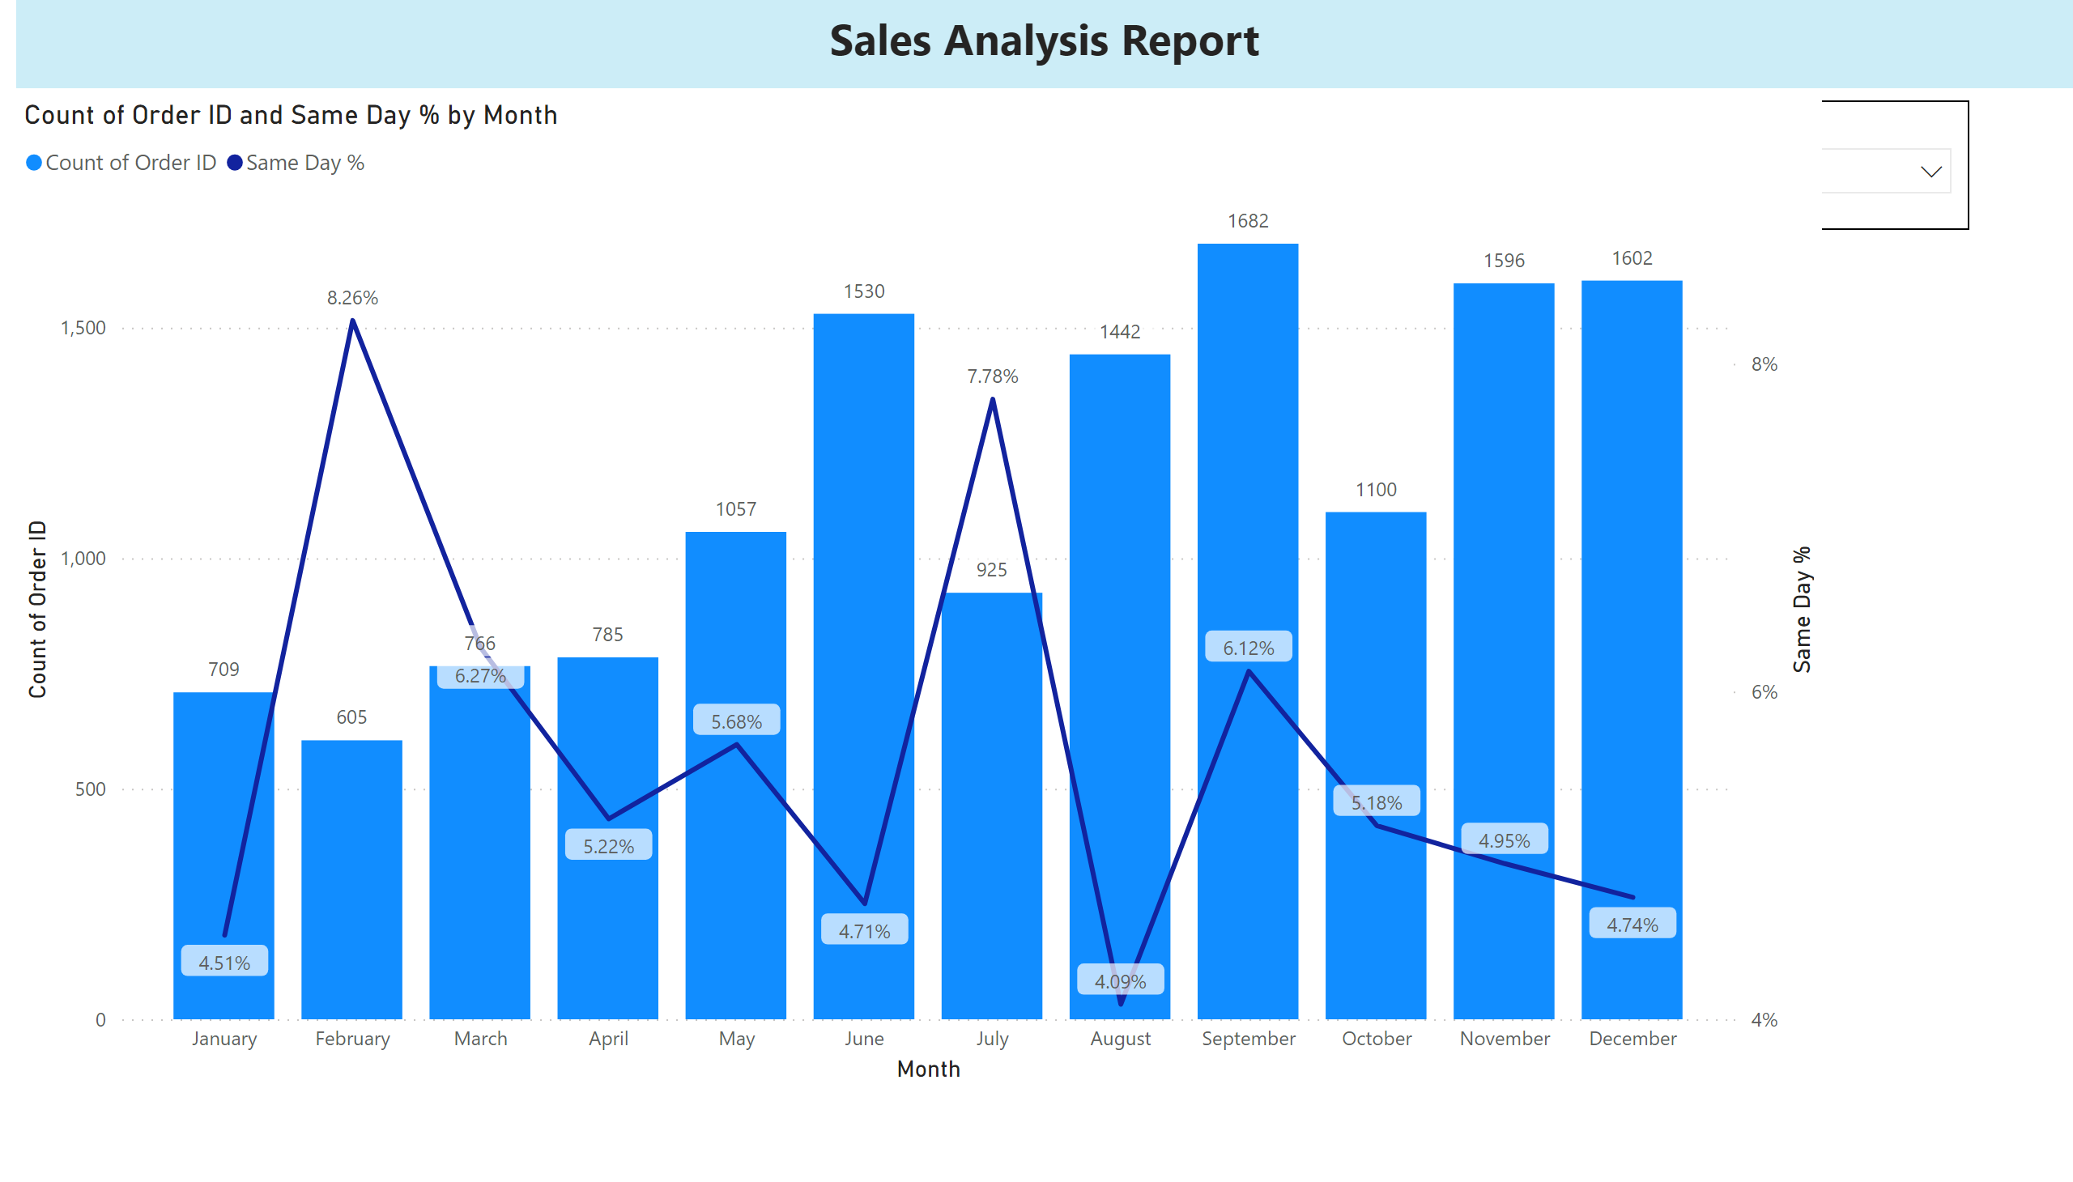
Page 5
Notes:
textbox
No alt text provided
Current Year Sales
No alt text provided
slicer
No alt text provided
slicer
No alt text provided
lineClusteredColumnComboChart
No alt text provided

Slide 5
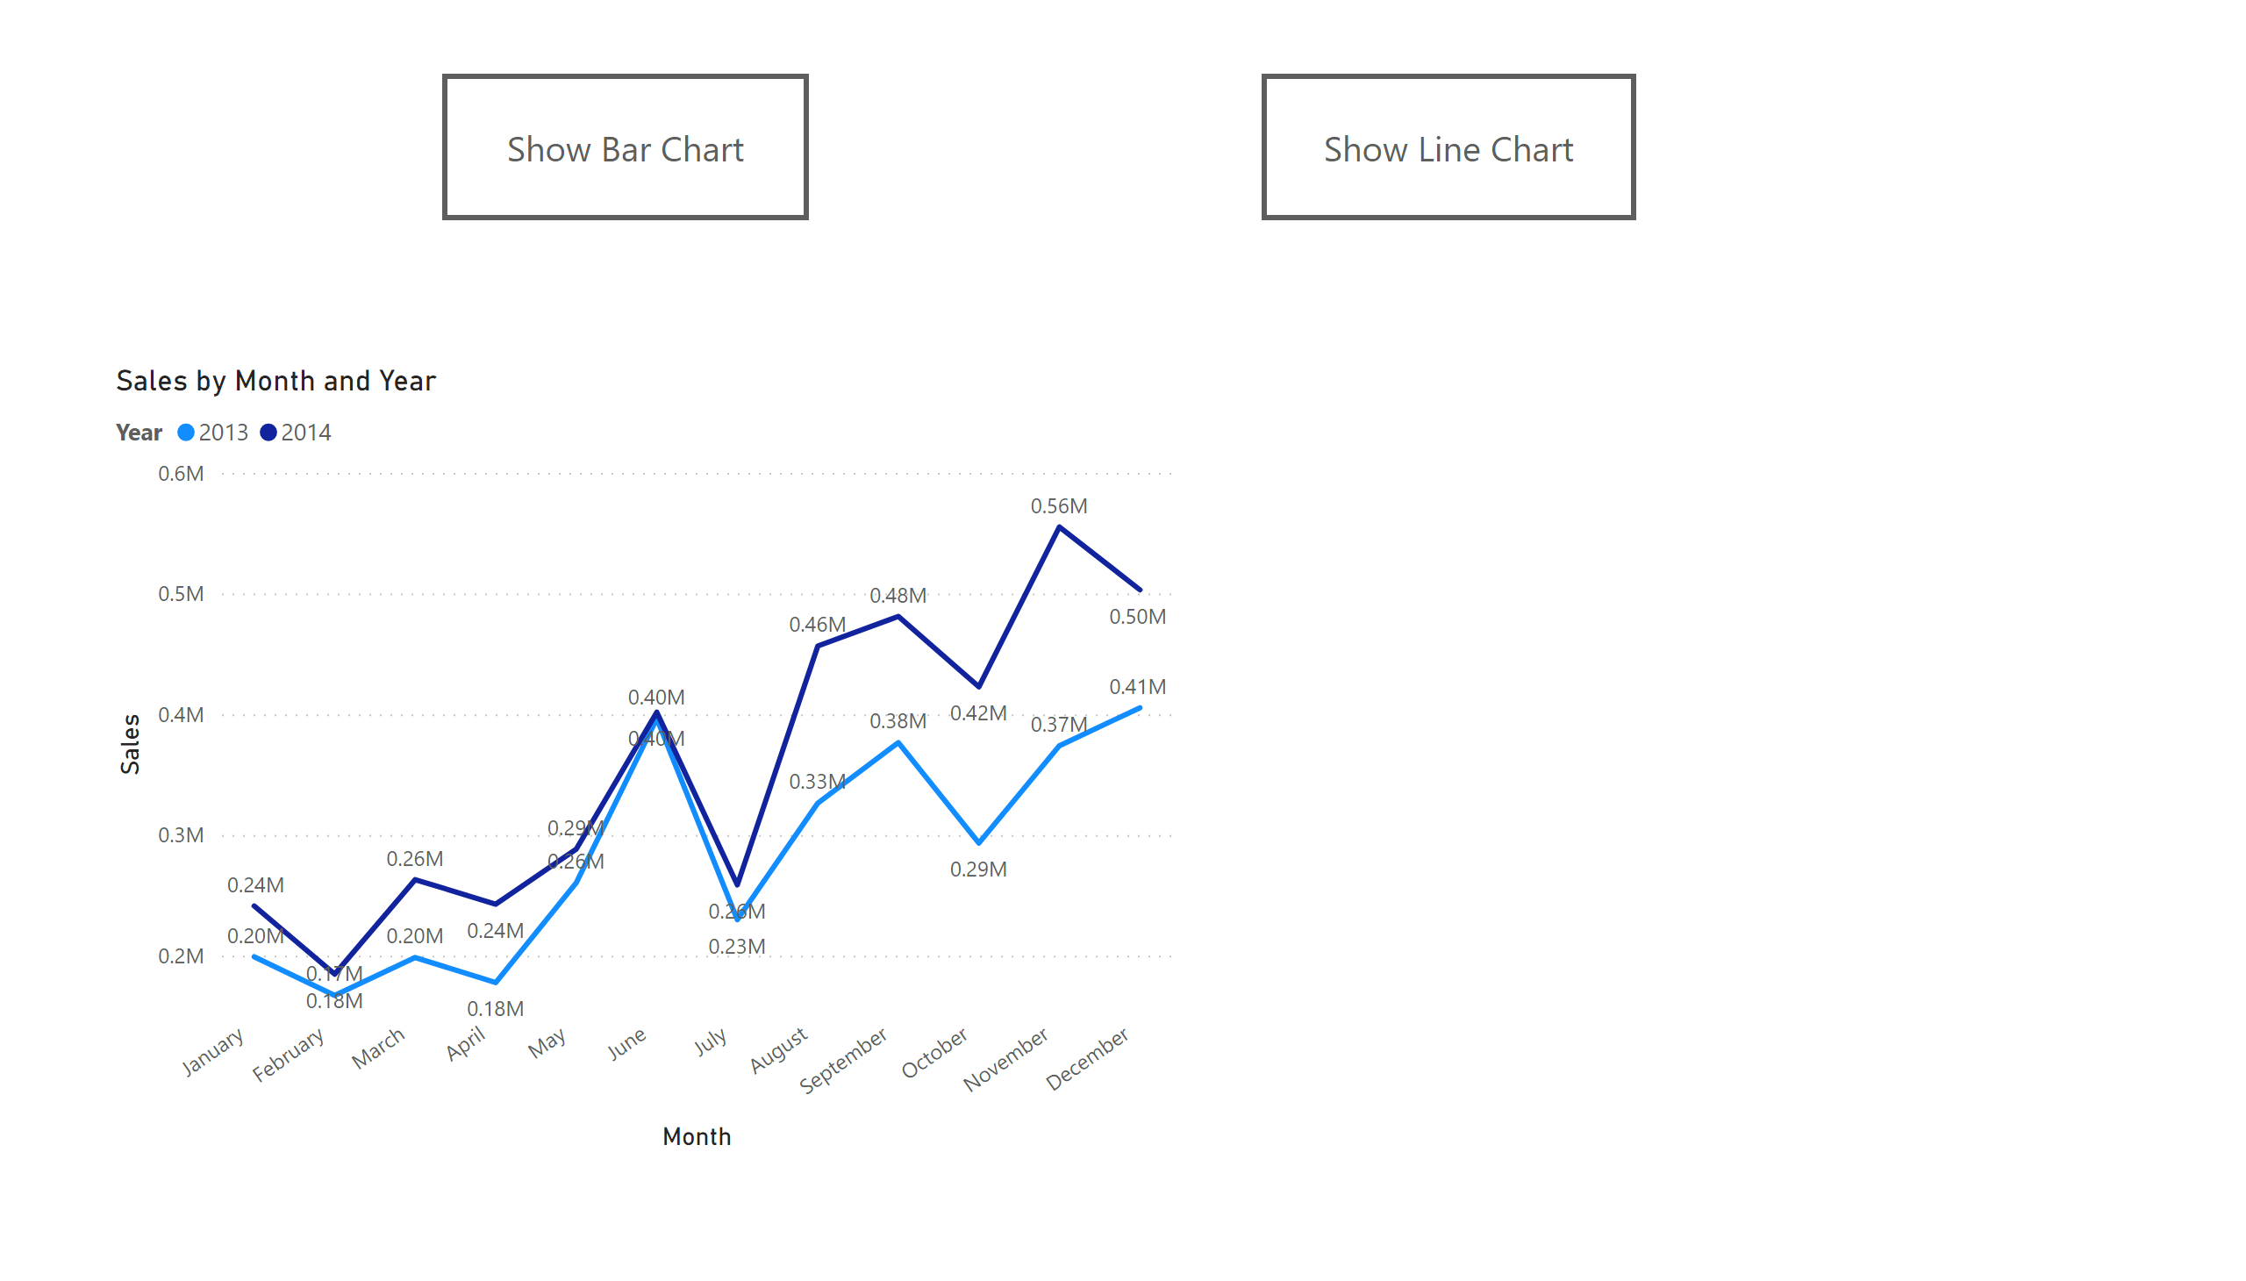
Page 6
Notes:
lineChart
No alt text provided
clusteredColumnChart
No alt text provided
Show Bar Chart
No alt text provided
Show Line Chart
No alt text provided

Slide 6
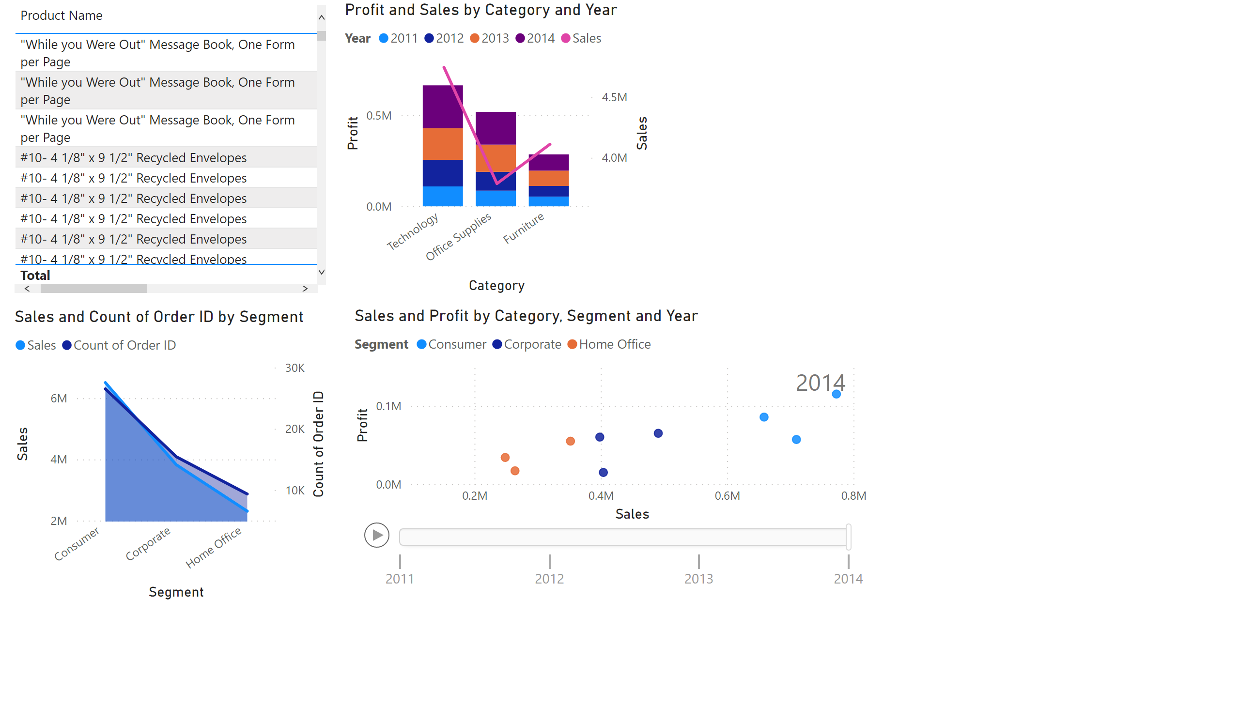
Page 7
Notes:
tableEx
No alt text provided
areaChart
No alt text provided
lineStackedColumnComboChart
No alt text provided
scatterChart
No alt text provided

Slide 7
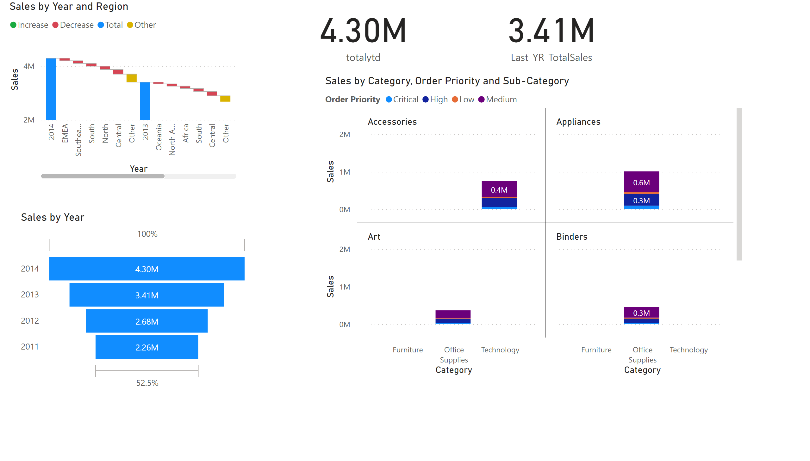
Page 1
Notes:
waterfallChart
No alt text provided
funnel
No alt text provided
card
No alt text provided
card
No alt text provided
columnChart
No alt text provided

